Slide 1


Problem Statement:
"In the gold loan application process, manual assessment of gold purity is a bottleneck, causing delays and operational costs. An innovative solution is needed to streamline the process by reducing assessment time, minimizing reliance on manual inspection, and integrating seamlessly into existing workflows. The solution should leverage technology for enhanced accuracy, scalability, and cost-effectiveness while ensuring a user-friendly experience."
Team Name:AURUM

Slide 2




AMAL THOMAS S5 CSBS RSET
BHARATH S S5 CSBS RSET
CELINA E JACOB
S5 CSBS
RSET
JOEPAUL VILSAN S5 CSBS
RSET

Slide 3
What are we addressing:
• Gold loan revolution: Introducing a portable gold purity checking process for faster, more accurate loan applications.
• Bye-bye manual hassles: Ditch costly, time-consuming inspections with tech-powered purity assessment.
• Customer experience boost: Functional, economic, and brand value gains from a streamlined loan process.
• Expensive Devices: We focus to implement a process which is affordable.

Slide 4
Value Delivered:
Functional Value: The device significantly reduces the time required for gold purity assessments, expediting the loan approval process and ensuring a more efficient workflow.
Economic Value: By minimizing the need for dedicated personnel for manual inspections, the solution addresses operational costs, providing economic value to the bank.
Brand Value: The adoption of innovative technology showcases a commitment to modernization and efficiency, enhancing the brand value of the financial institution.

Slide 5
Customers
• Faster loans for customers: On-site purity checks reduce wait times and boost convenience.
• Cost savings for banks: Ditch manual inspections and unlock operational efficiency.
• Win-win innovation: Tech-driven purity checker enhances brand value for all parties.

Slide 6
Solution
Domain: Intelligent Process Management (IPM),UI
1. IPM (Intelligent Process Management):
Role: Orchestrates and optimizes gold loan application processes intelligently.
Functions:
Automated workflows for gold purity assessment.
Real-time decision-making based on intelligent algorithms.
Integration of data streams from specific gravity, conductivity, and electromagnetism tests.
Benefits: Improved efficiency, reduced processing times, and enhanced decision accuracy.

Slide 7
2. UI (User Interface):
Role: Facilitates user interaction and provides real-time feedback.
Functions:
Real-time feedback during gold purity assessment.
Data visualization for easy interpretation.
Seamless input and retrieval of data for bank employees.
Benefits: Enhanced user experience, improved communication, and transparency in the gold loan application process.
Integrated Solution: The Intelligent Gold Purity Checker combines Intelligent Process Management and a User-Friendly Interface for a streamlined and efficient gold loan application process, delivering enhanced decision-making, efficiency, and customer satisfaction in a single solution.

Slide 8
DATA FLOW
Step 1: Going to the Customer's House
Step 2:Specific Gravity Test
Step 3: Conductivity Test
Step 4: Electromagnetism Test
Step 5:KYC Verification
Step 6:Instant Credit to Customer's Account

Slide 9
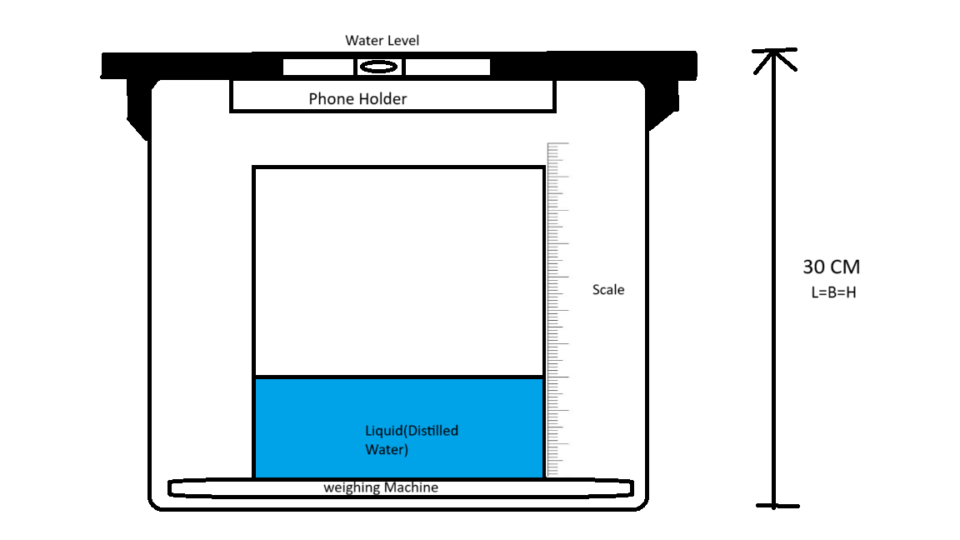
Specific Gravity Test (approx. 5 mins)

Slide 10
Procedure
DENSITY=MASS/VOLUME
SPECIFIC GRAVITY=DENSITY OF SUBSTANCE/DENSITY OF WATER
SPECIFIC GRAVITY IS UNIQUE PROPERTY OF A MATERIAL
24K GOLD : 19.3
22K GOLD : 17.9
18K GOLD: 16.8
​

Slide 11
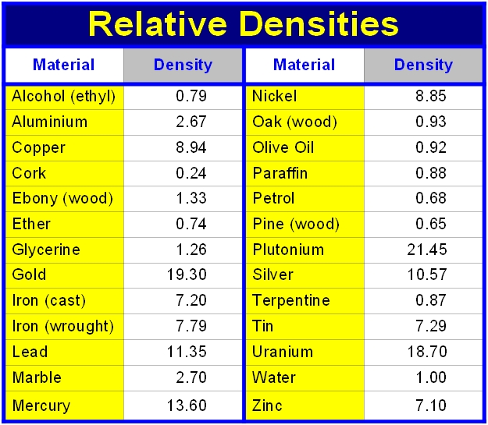
SPECIFIC DENSITY TABLE

Slide 12
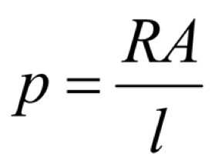
RESISTIVITY TEST (Approx 7 mins)
*Dry Water from object first
Like Specific Gravity, Resistivity is unique property of Material.
RESISTIVITY,

Slide 13
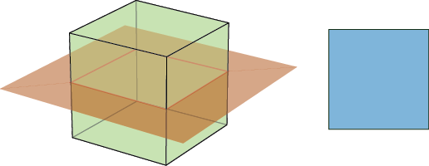
CALCULATE CROSS SESSIONAL AREA()
5 CM
5 CM

Slide 14
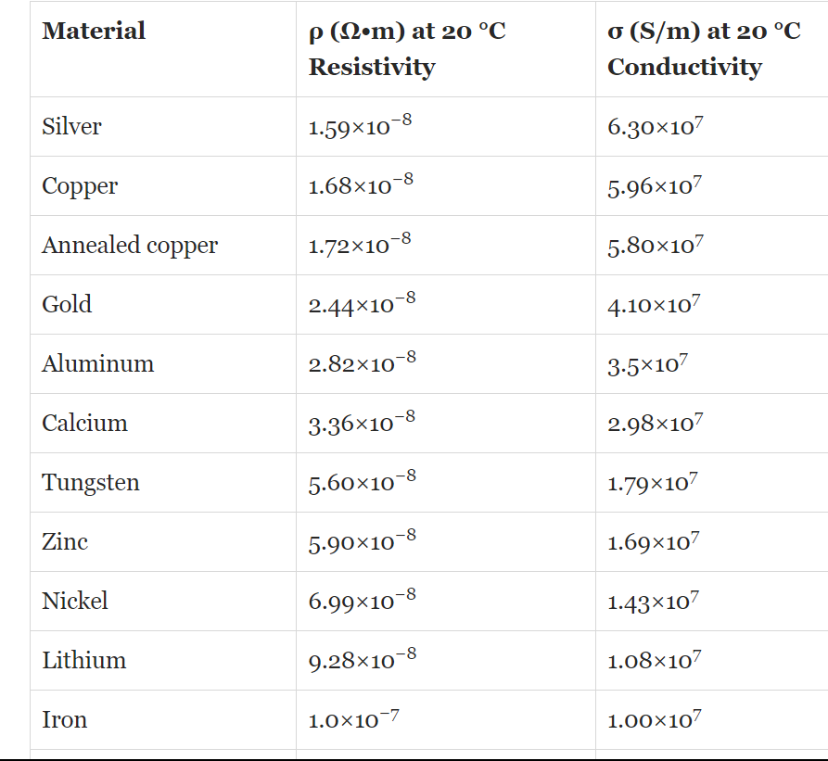

Slide 15
Magnetic Property Test (Approx 3 mins)
Either by visual changes in object.(Attraction or Repulsion)
Or, By measuring Magnetic Susceptibility.(If an object can be magnetized by applying magnetic field)

Slide 16
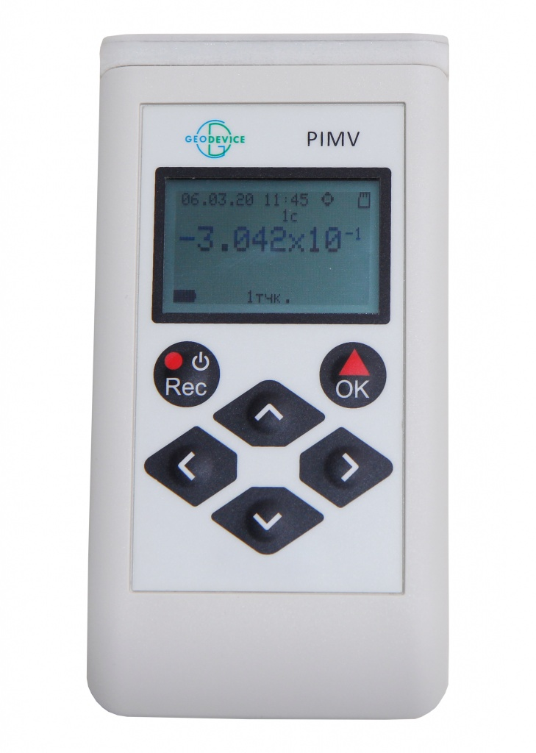
Magnetic Susceptibility Meter

Slide 17
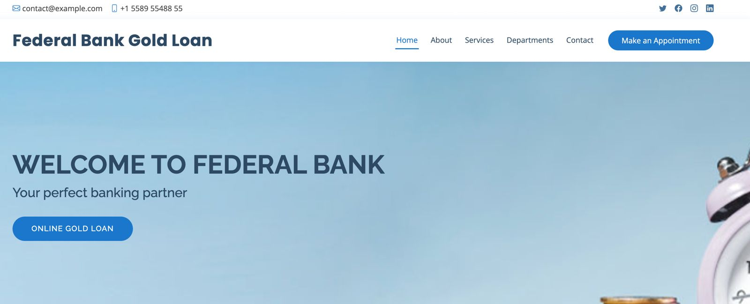

Slide 18
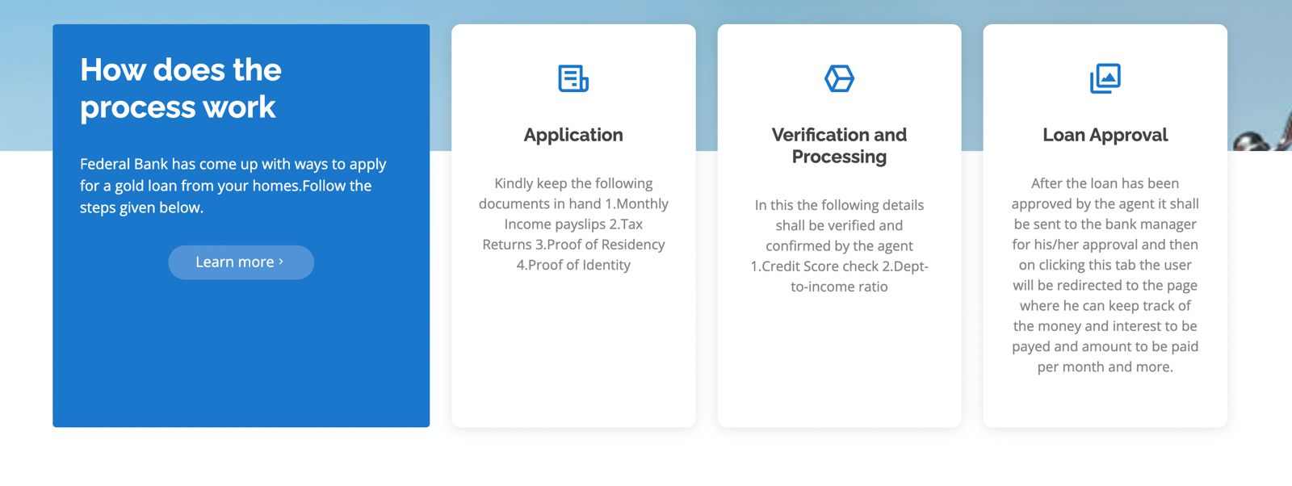
After Gold Verification:

Slide 19
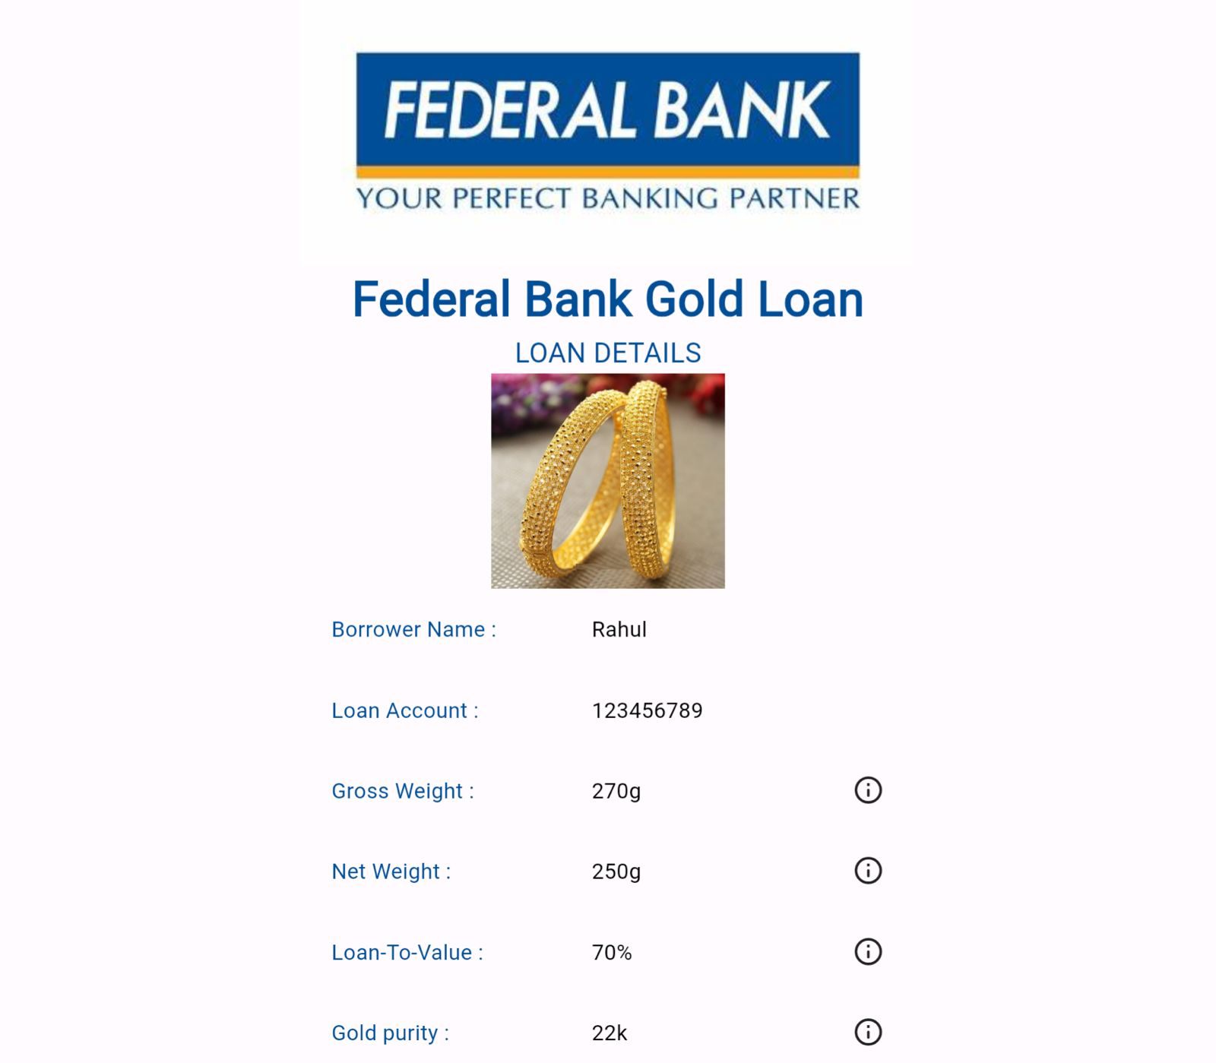

Slide 20


